Slide 1
J-K Flip-Flop
Joshua Gould
12/5/2017
ECE 09.414 VLSI Design
Dept. of ECE
Henry M. Rowan College of Engineering
Rowan University

Slide 2
Outline
J-K Flip-Flop Overview / Description
Features / Problems
Master Slave Design
Block Diagram
Truth Table
K-Map Minimization
Worst Case Design
Logical Effort, Number of Stages, Delay
Gate Sizes for Optimized Design
Standard Cell Library & Layout Simulations
Conclusion

Slide 3
Overview
JK Flip-Flop with Clear
  like the SR flip-flop, includes a "toggle" function when inputs are set to 1.
  Like all flip-flops, outputs only change with a clock pulse
J (set) and K (reset) to indicate the different operations of the flip-flop.
In other words:
  J=1, K=0 sets the flip-flop
  J=0, K=1 resets the flip-flop
  J=1, K=1 toggles the flip-flop

Slide 4
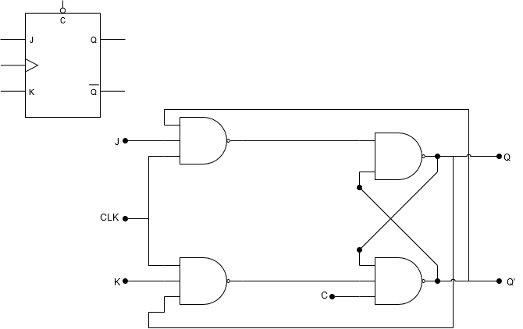
Block Diagram

Slide 5
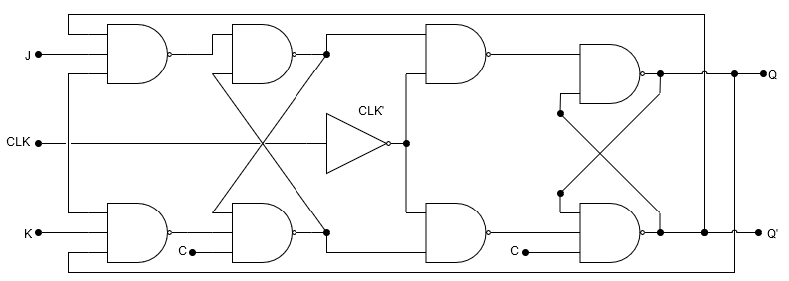
Block Diagram – Master/Slave
Master Latch
Slave Latch

Slide 6
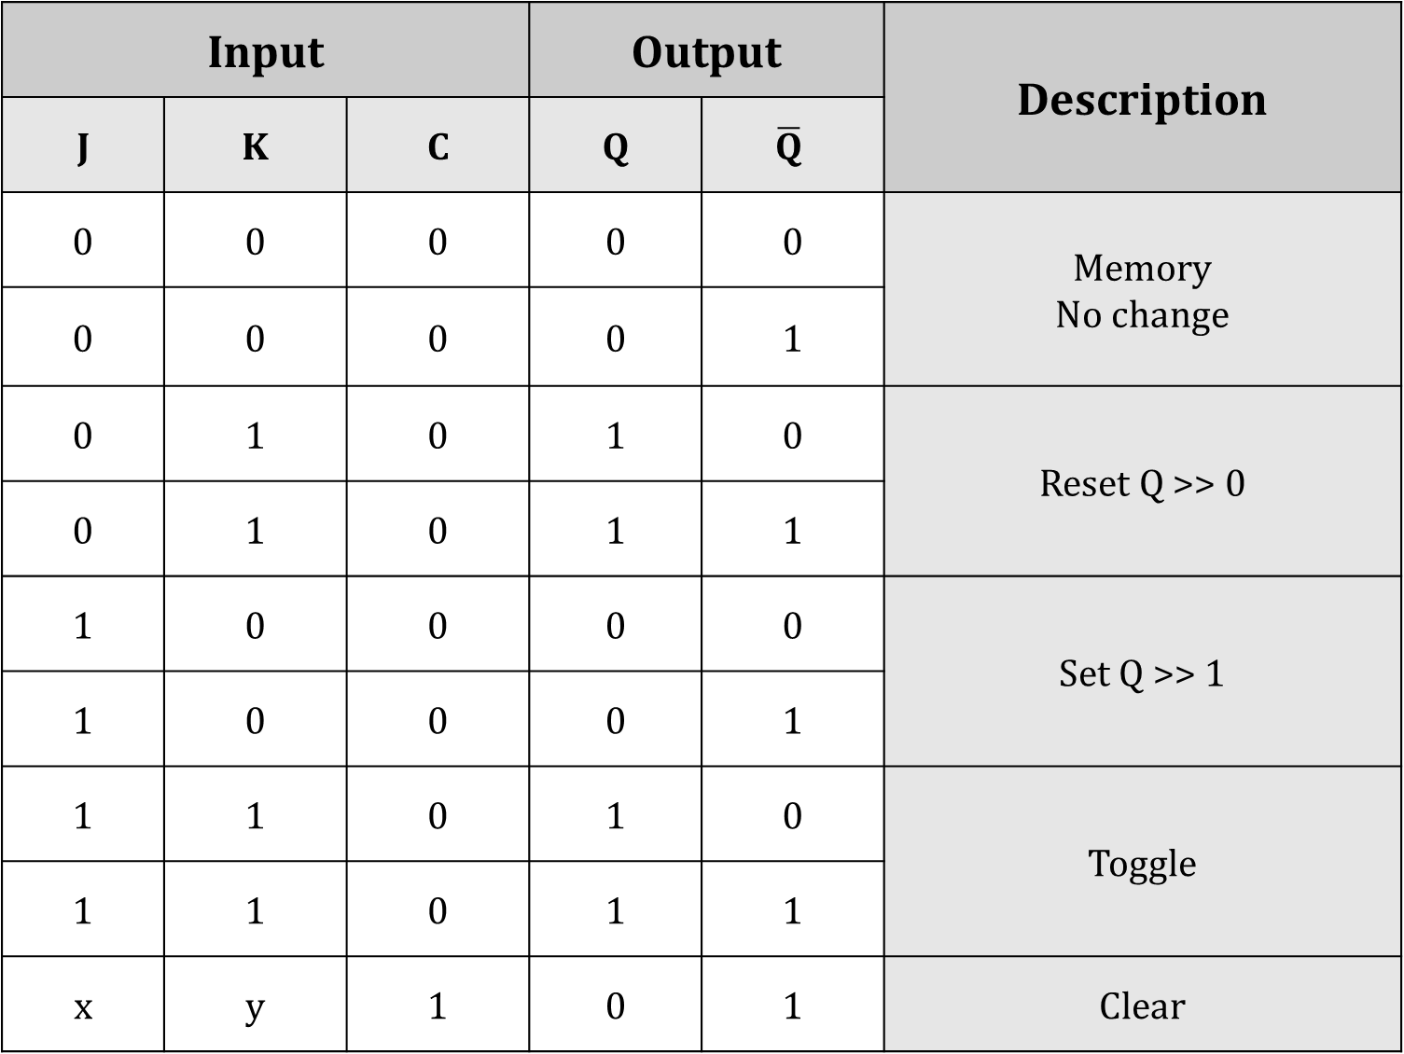

Slide 7
Minimization Using K-Map

Slide 8
Logic Design

Slide 9
Worst Case Logical Path

Slide 10
Logical Effort, Number of Stages, Delay

Slide 11
Spreadsheet Comparing Different Designs

Slide 12
Gate Sizes for Optimized Design

Slide 13
Standard Cell Library

Slide 14
Standard Cell Library Layouts

Slide 15
Standard Cell Library Extracted Layouts

Slide 16
Standard Cell Library Simulation
“Spectre” Netlist

Slide 17
Standard Cell Library Simulation
Input / Output Waveforms

Slide 18
Snap-together Standard Cells
Circuit Layout

Slide 19
Snap-together Standard Cells Simulation
Input / Output Waveform

Slide 20
Delay Comparison
Logical Effort vs. Spectre

Slide 21
Conclusions

